Slide 1


Data Communication and Computer Networks
Department of Computer Science PAF-KIET North Campus

Slide 2
Chapter 2 - Network Models

Slide 3
Network Models
Networks require a combination of hardware and software to send data from one location to another
To make communications efficient
many components are involved, each with a specific function or service

Slide 4
Layered Tasks
Hierarchy
 The complex task is broken into smaller subtasks
Services
 The higher layer uses the services of the lower layer

Slide 5
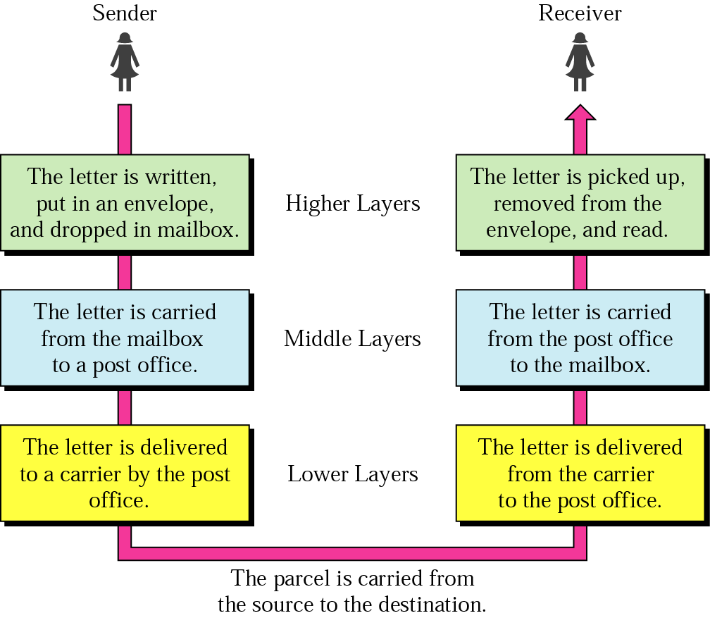
Example of Sending a letter

Slide 6
Postal Mail Example
Sender : Higher Layer, Middle Layer and Lower Layer
Carrier: Truck, train, airplane, boat or a combination thereof.
Receiver: Lower Layer, Middle Layer and Higher
Layer
Hierarchy: Tasks must be done in the order given in the hierarchy
Services: Each layer at the sending site uses the services of the layer immediately below it.

Slide 7
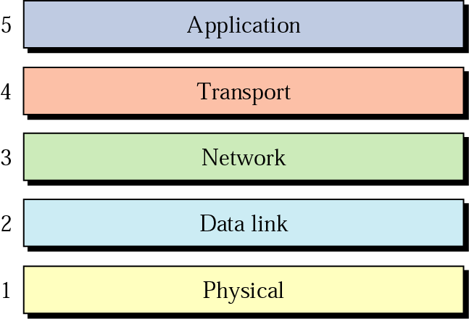
Internet Model
Dominant model in data communications and networking
5 ordered layers; often referred to as TC P/IP protocol suite

Slide 8
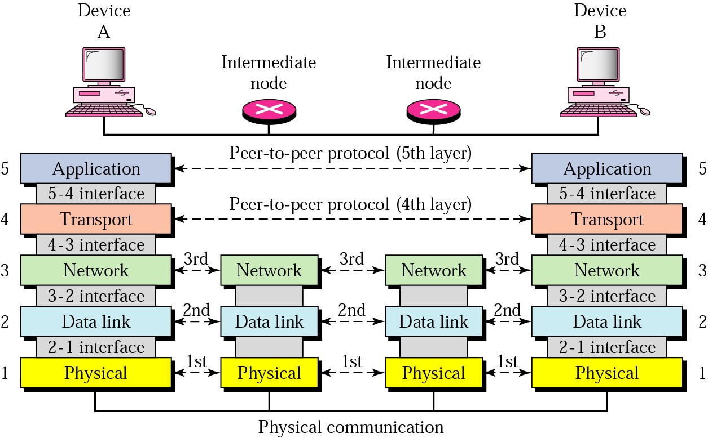
Peer-to-Peer Process

Slide 9
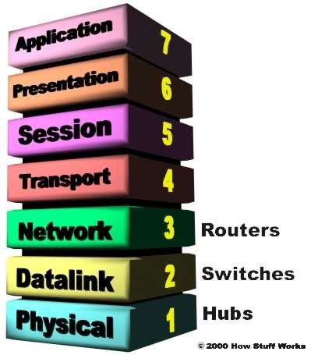
OSI Layers

Slide 10
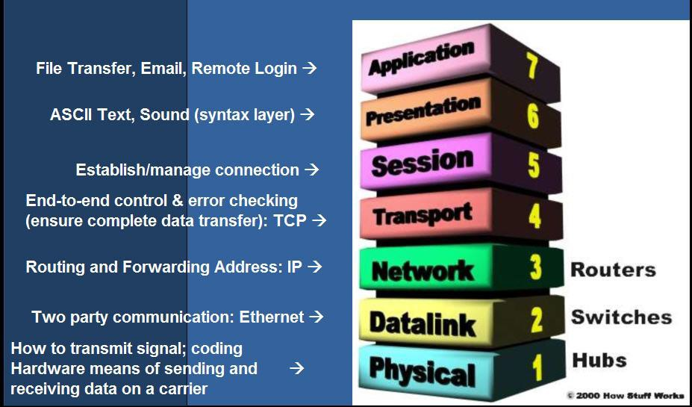
OSI Layers

Slide 11
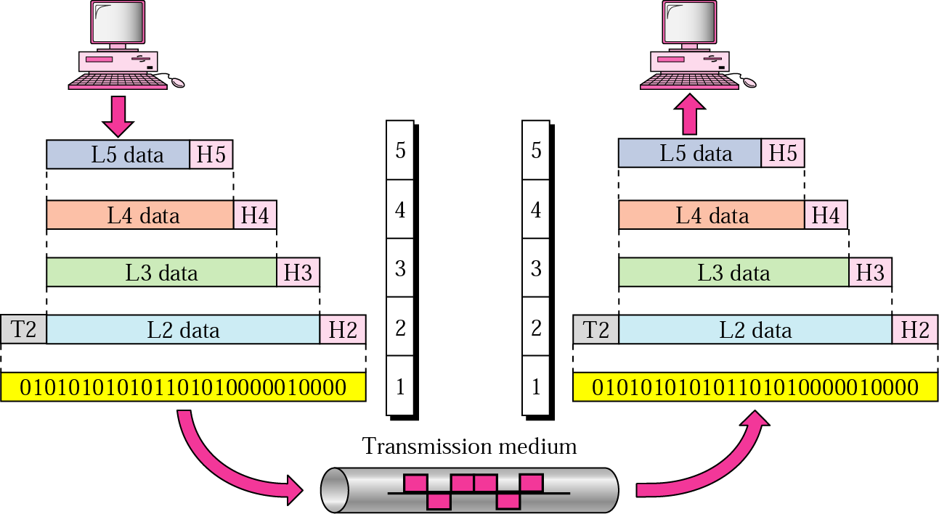
Data Exchange Between Two Devices

Slide 12
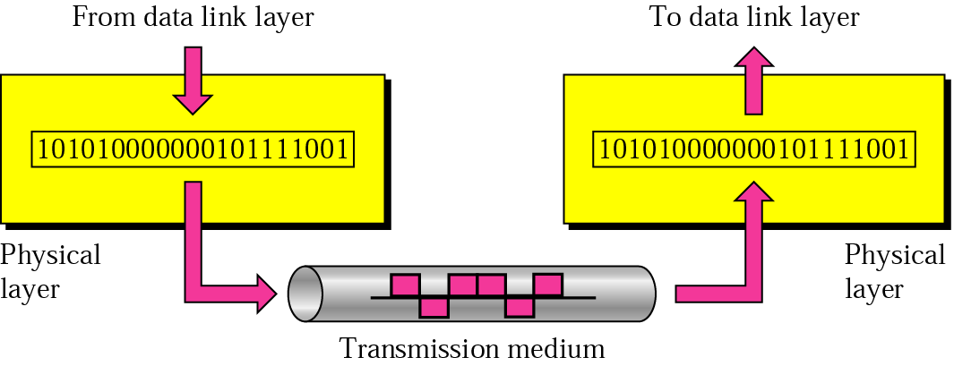
Physical layer

Slide 13
Physical Layer Responsibilities
Physical characteristics of interfaces and media
– It defines the characteristic of the interface between devices and media. It also define the type of transmission media
Representation of bits
The bit stream must be encoded into signals. It defines the type of representation ( how 0, 1 are changed to signal).
Data rate
It defines the number of bits sent per second and also the d uration of bits
Synchronization of bits
The sender and receiver must be use the same bit rate also the receiver clock must be synchronized

Slide 14
Physical Layer Responsibilities
Line configuration
Physical layer is concerned with the connection of devic es to the media ( point-to point or multipoint)
Physical topology
How devices connected to make a network
Devices can connected by using Star, mesh , bus, ring or hybrid topology
Transmission mode
It defines the direction of transmission between two dev ices (simplex, half-duplex, or full duplex)

Slide 15



The physical layer is responsible for transmitting individual bits from one node to the next.

Slide 16
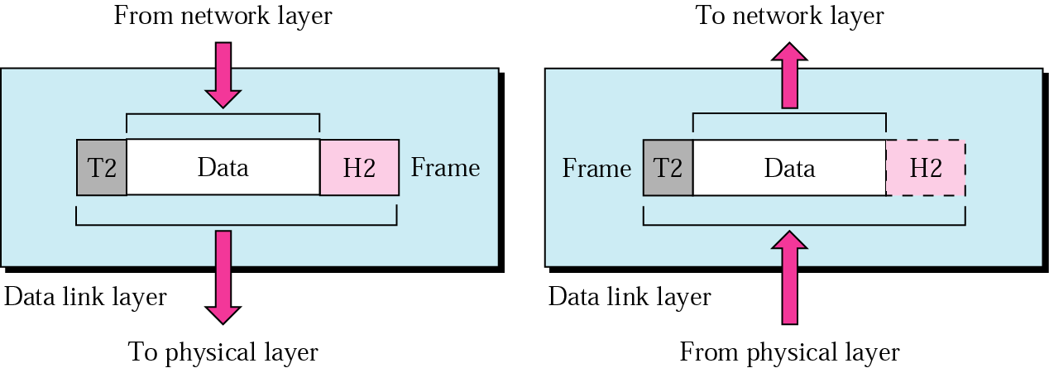
Data link layer

Slide 17
Data Link Layer Responsibilities
Responsible for moving frames from one hop (node) to the next
Framing
Divide the stream of bits received from network layer into data units called frames
Physical addressing
Known also as the MAC or link address
Data Link Layer adds a header to the frame to define the
sender and receiver address of the frame.
Ethernet uses 6-bytes (48-bits) physical address that imprinted on the NIC

Slide 18
Data Link Layer Responsibilities
Flow control
It imposes a flow control mechanism , if the data rate at the receiver is less than produced by sender the data link layer imposes a flow control to avoid overwhelming at the receiver
Error control
Add mechanisms to detect and retransmit damaged or lost frames.
Prevent also duplication of frames.
Error control is normally achieved through a trailer added to the end of frame.
Access control
When two or more devices are connected to the same link, data link layer protocols are necessary to determine which device has control over the link at given time

Slide 19


Note:
The data link layer is responsible for transmitting frames from
one node to the next.

Slide 20
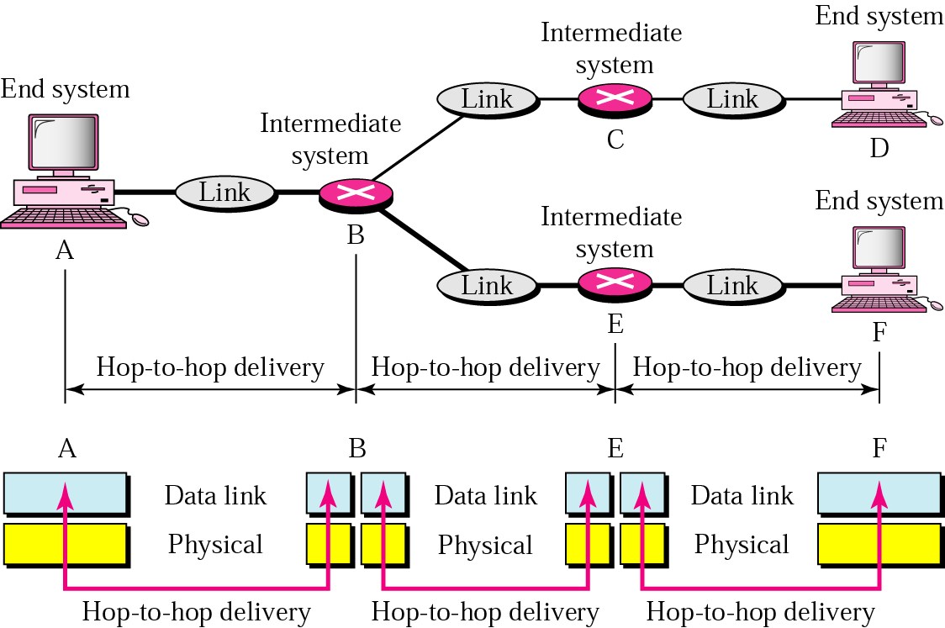
Node-to-node delivery

Slide 21
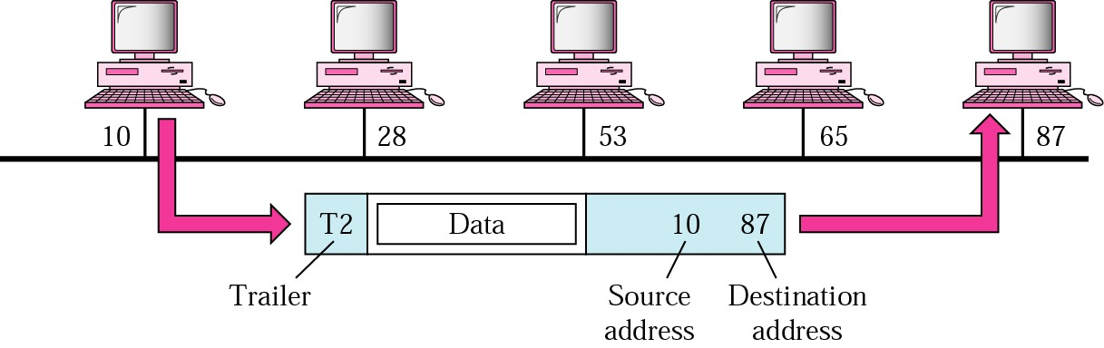
Example
In below figure a node with physical address 10 sends a frame to a node with physical address 87. The two nodes are connected by a link. At the data link level this frame contains physical addresses in the header. These are the only addresses needed. The rest of the header contains other information needed at this level. The trailer usually contains extra bits needed for error detection

Slide 22
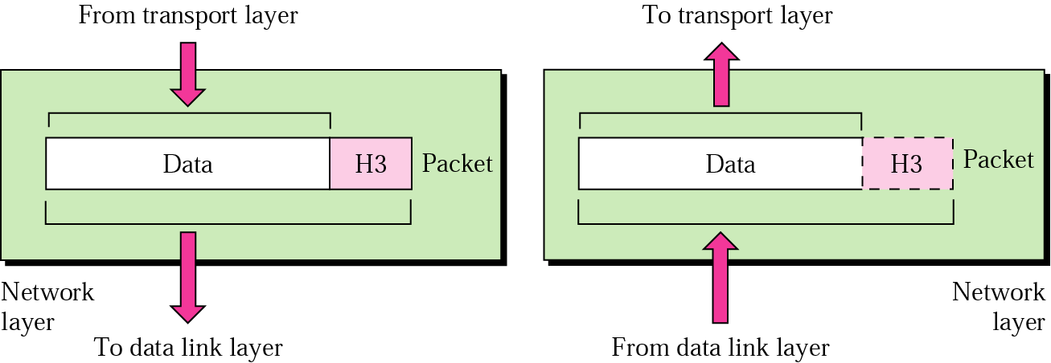
Network layer

Slide 23
Network Layer Responsibilities
Responsible from the delivery of packets from the original source to the final destination across multiple networks
If two systems are connected to the same link, there is no need for network layer
Logical addressing
Network layer adds unique ( IP or logical address) to the
packet.
IP addresses are necessary for universal communications that are independent of physical network
No two host address on the internet can have the same IP address
IP addresses 32-bit address that uniquely define a host connected to the Internet

Slide 24
Network Layer Responsibilities
Routing
Provide the routing mechanism for the router which route the packet to their final destination.
Routers: devices used when independent networks are connected to create an internetworking ( network of networks)

Slide 25


Note:
The network layer is responsible for the delivery of packets from the original source to the
final destination.

Slide 26
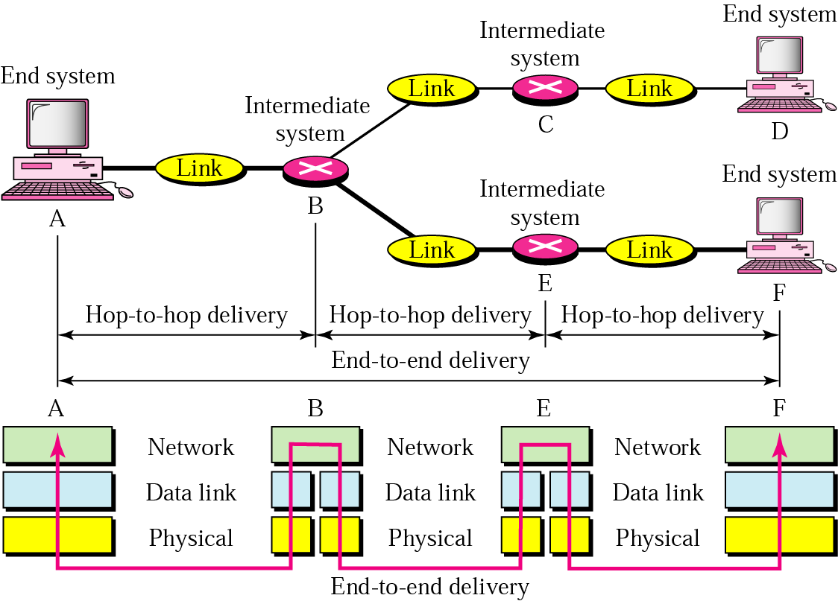
Source-to-destination delivery

Slide 27
Source-to-destination delivery
In Figure 2.11 we want to send data from a node with network address A and physical address 10, located on one LAN, to a node with a network address P and physical address 95, located on another LAN. Because the two devices are located on different networks, we cannot use physical addresses only; the physical addresses only have local jurisdiction. What we need here are universal addresses that can pass through the LAN boundaries. The network (logical) addresses have this characteristic.

Slide 28
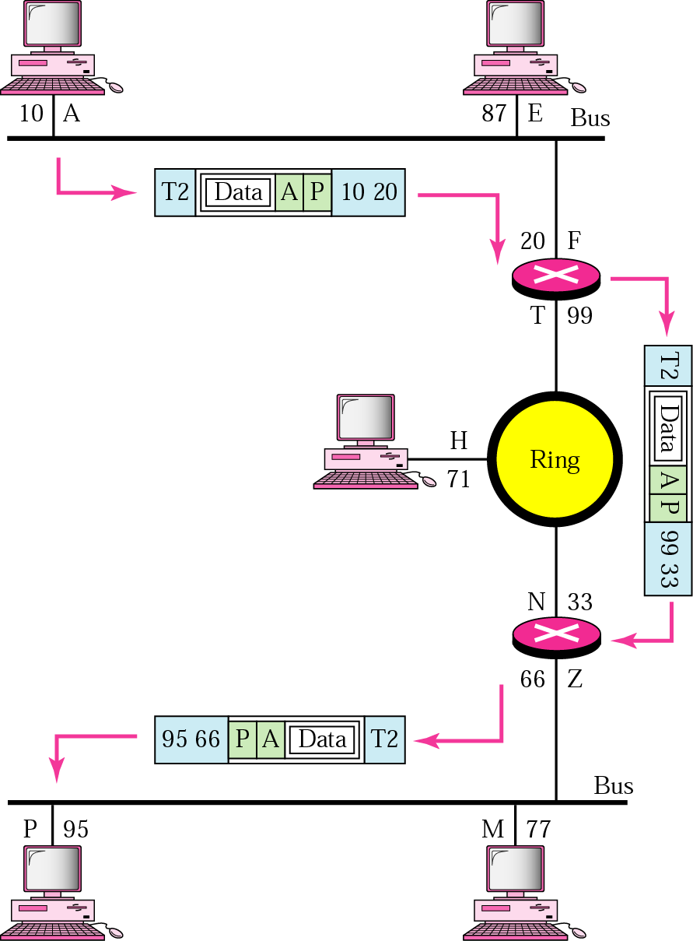
Example 2
Figure 2.11

Slide 29
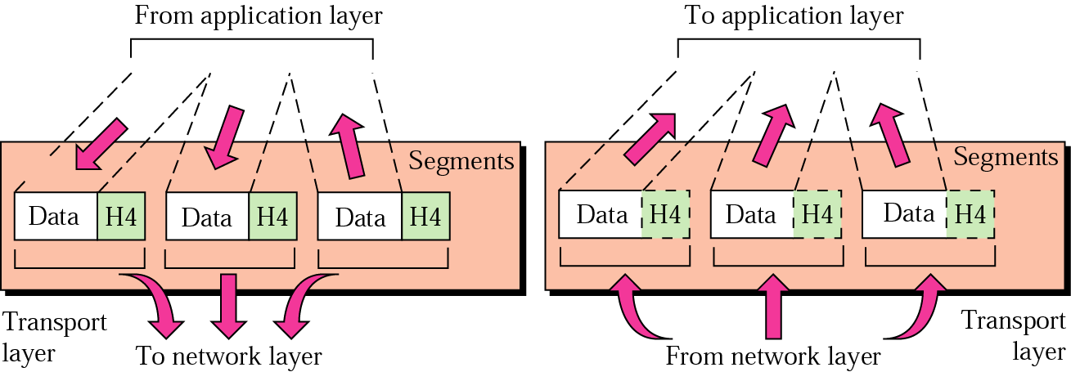
Transport layer

Slide 30
Transport Layer Responsibilities
The transport layer is responsible for the process-to-process delivery of the entire message. It ensures that the whole message arrives intact and in order, overseeing both error control and flow of control at the process-to-process level
The major duties of the transport layer are as follows:
Port addressing: The network layer gets each packet to the correct computer, the transport layer gets the entire message to the correct process on that computer using a port address.

Slide 31
Transport Layer Responsibilities
Segmentation and reassembly: A message is divided in transmittable segments, each segment containing a sequence number. These numbers enable the transport layer to reassemble the message correctly upon arrival at the destination and to identify and replace packets that were lost in the transmission.
Connection control: The transport layer can be either connectionless or connection-oriented. A connectionless transport layer treats each segment as an independent packet and deliver it to the transport layer at the destination machine. A connection-oriented transport layer makes a connection with the transport layer at the destination machine first before delivering the packets. The connection is terminated once all packets are transferred.

Slide 32
Transport Layer Responsibilities
Flow control: end-to-end flow control rather than across a single link as done in the data link layer.
Error control: end-to-end error control rather than across a single link as done in the data link layer.

Slide 33
Note:
The transport layer is responsible for delivery of a message from one process to another.

Slide 34
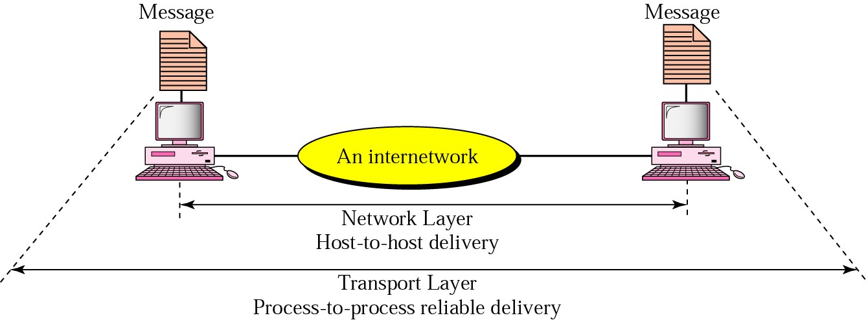
Reliable process-to-process delivery of a message

Slide 35
Example 3
Figure shows an example of transport layer communication. Data coming from the upper layers have port addresses j and k (j is the address of the sending process, and k is the address of the receiving process).
Since the data size is larger than the network layer can handle, the data are split into two packets, each packet retaining the port addresses (j and k). Then in the network layer, network addresses (A and P) are added to each packet.

Slide 36
Session Layer
It establishes, maintains and synchronize the interaction between communicating system
Monitors session identification so that only designated parties can participate
Examples: name lookup and user logon and logoff
E.g., DNS name resolution, FTP’s logon/logoff
Function
Dialog control
Allows two systems to enter into dialog
It allows the communication between two processes to take place in either half-duplex or full-duplex.
Synchronization
It allows a process to add checkpoints into a stream of data o So that if a failure of some sort occurs between checkpoints, the layer can retransmit all data since the last checkpoint.

Slide 37
Presentation Layer
Concerned with the syntax and semantics of the information exchanged between two systems
Functions
Translation
At the sender it changes the information from its sender –dependent format into common format.
At receiving, changes the common format into its receiver-dependent format
Encryption
To ensure privacy and security
Compression
Data compression reduces the number of bits contained in the information.
It is important in the transmission of multimedia such as audio or video

Slide 38
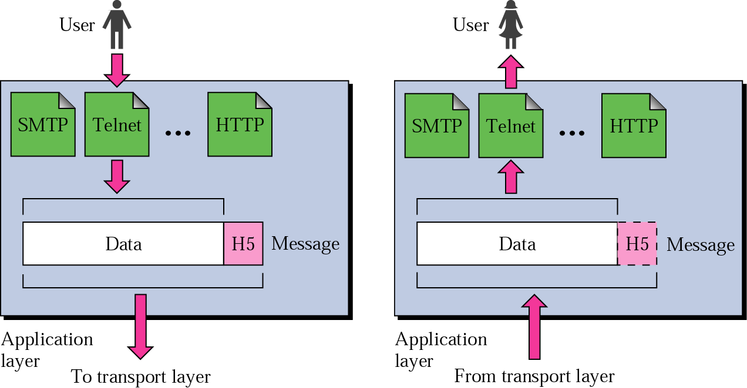
Application layer

Slide 39
Application Layer Responsibilities
Set of interfaces to access networked services
Responsible for providing services to the user
Mail services
SMTP: Simple mail transfer protocol used to send electronic mail on the internet
File transfer and access
FTP : A protocol enable moving file across the network
Remote log-in
Telnet: A service that enables users on the intern et to log onto remote systems from their own hos t system
Accessing the World Wide Web
HTTP: Hyper text transfer protocol used for network file transfers in WWW environment

Slide 40


Note:
The application layer is responsible for providing services to the user.

Slide 41
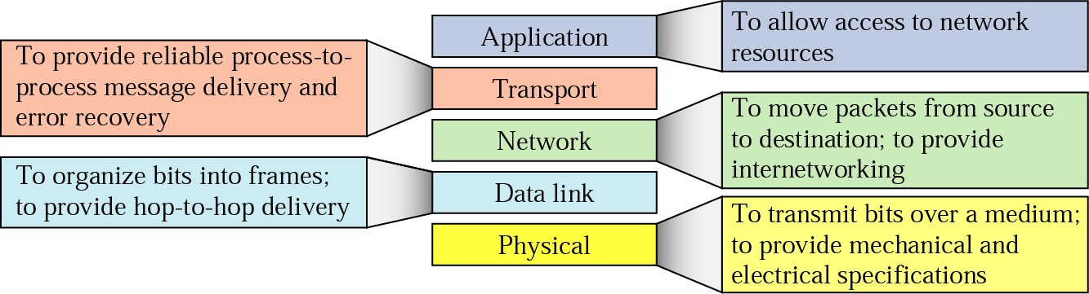
Summary of duties

Slide 42
OSI Model
Established in 1947, the International Standards Organization (ISO) is a multinational body dedicated to worldwide agreement on internati onal standards.
An ISO standard that covers all aspects of network communications is the Open Systems Int erconnection (OSI) model. (theoretical model f or networks of all kinds)
OSI reference model, drafted in late 1970s by
ISO
By 1983, the draft became ISO Standard 7498
Common framework for developers and students of n etworking to work with and learn from
Attempt to develop a working set of protocols and te chnologies based on the OSI model and to put those efforts into common use never materialized

Slide 43
OSI Model
Networking can be separated into a series of related tasks
Each task can be conceptualized as a single layer, of the communication process
Reduces complexity of networked communications into series of interconnected tasks and activities
“Divide and conquer” approach: relationship a mong tasks persists, but each can be handled separately, and its issues solved independently
Reference models and standards enable intero perability among layers

Slide 44
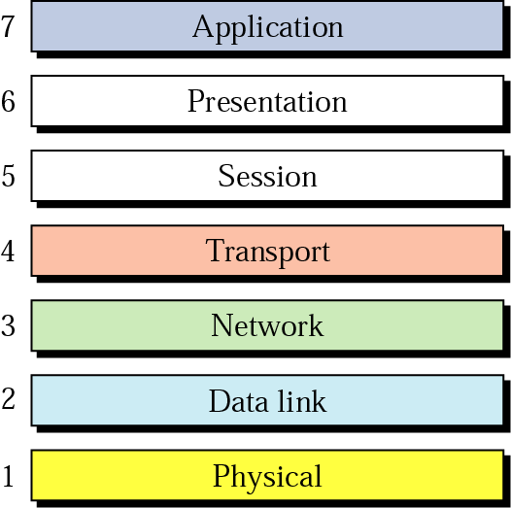
OSI Model

Slide 45
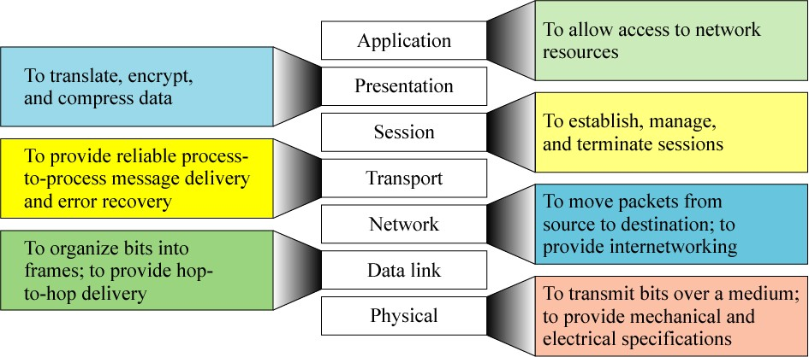
Summary of OSI model

Slide 46
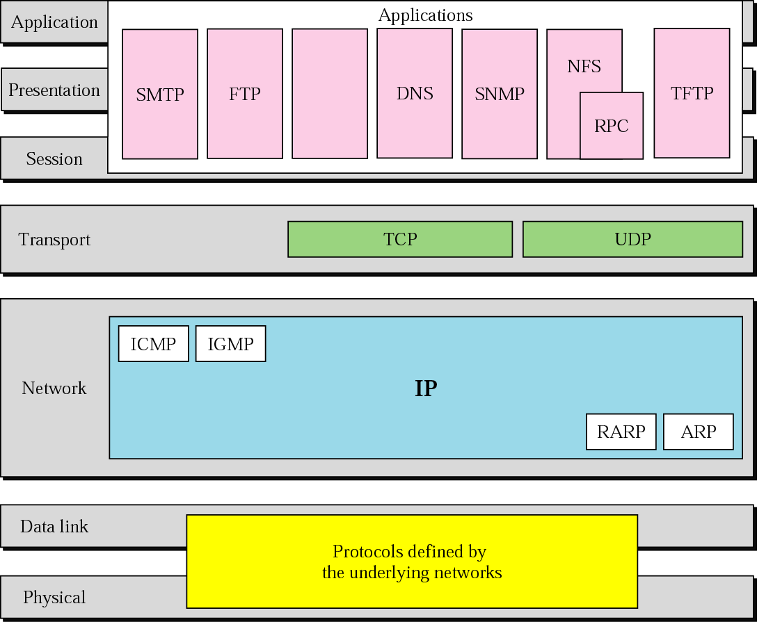
TCP/IP and OSI model

Slide 47
OSI vs TCP/IP
OSI
TCP/IP
Application
User space
Presentation
Application
Session
Software
Transport
Transport
Operating System
Firmware
Network
Network
Hardware
Data Link
Data Link
Physical
Physical

Slide 48
Some common data communications standards
Layer | Common Standards
5. Application layer | HTTP, HTML (Web) MPEG, H.323 (audio/video) IMAP, POP (e-mail)
4. Transport layer | TCP/UDP (Internet) SPX
3. Network layer | IP (Internet) IPX (Novell LANs)
2. Data link layer | Ethernet (LAN) PPP (dial-up via modem)
1. Physical layer | RS-232c cable (LAN) Category 5 twisted pair (LAN) V.92 (56 kbps modem)

Slide 49
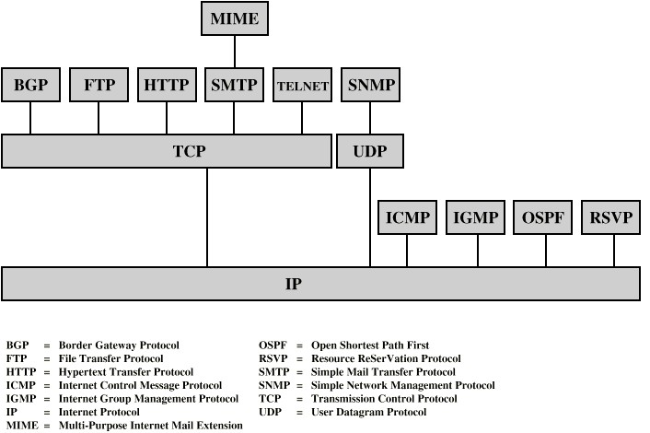
Some Protocols in TCP/IP Suite

Slide 50
Thank You

